Slide 1

Isolation in the states
Stay at home orders in the United States and their effect on testing

Slide 2
Hypothesis: early statewide stay-at-home orders will have a significant negative correlation to absolute positive and positive test ratio.
The COVID-19 pandemic has affected every state in the United States of America. Each state has chosen to pursue a different strategy when it comes to dealing with this pandemic. While most have instituted stay-at-home orders several have not. Here I will examine the relationship between stay-at-home orders and the absolute number of positive tests performed as well as the ratio of positive tests to negative.

Slide 3
Variables to be explored:
Date
This variable will allow us to see how COVID-19 data has changed over time. Hopefully this will help us visualize and quantify the effect of social distancing measures on virus transmission.
State
This is the geographic location I will use in this analysis. For future exploration, looking at county or country level data could be very useful. Some interesting expansions of this examination could involve counties in states without statewide policies who chose to inplement county-wide stay-at-home policies. Similarly, countries with country wide stay-at-home policies as compared to countries without federal guidelines.
New_negative, new_positives, new_tests
Given the lack of extensive contact tracing and testing in the United States, it is difficult to get an accurate picture of COVID-19 transmission in our communities. Often only the most sick qualify for testing and many with known exposures and mild symptoms go without testing due to lack of resources. To help negate this complication, I have chosen to examine the ratio of new positive to new negative cases in the hopes that this statistic will help provide insight into the not just the raw number of cases isolated but also the proportion of the cases tested that are positive. I would expect to see both absolute positive and positive ratio to decrease in states with effective and early social distancing measures.

Slide 4
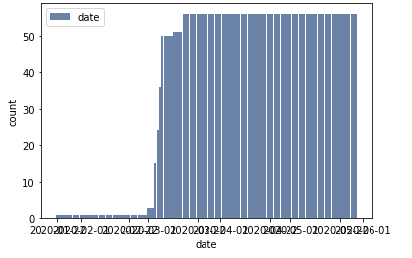
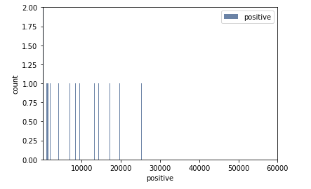
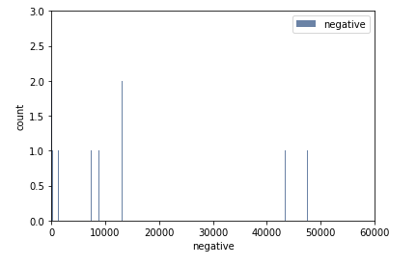
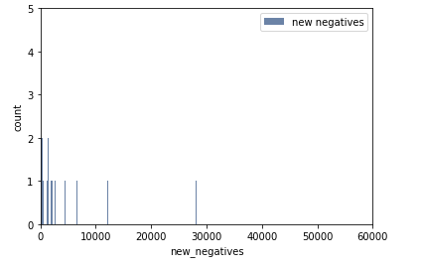
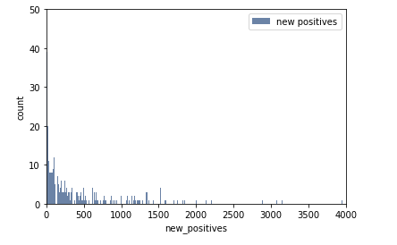
Histograms

Slide 5
Mean, Var, and Std
 | positive | negative | new_positive | new_negative
Mean | 12976.11388 | 76926.21436 | 363.2461796 | 3008.679506
Var | 1322322743 | 25203108511 | 739131.5813 | 45225882.9
Std | 36363.7559 | 158754.8693 | 859.7276204 | 6725.019175

Slide 6
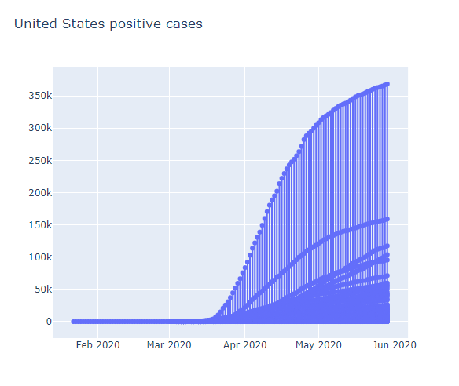
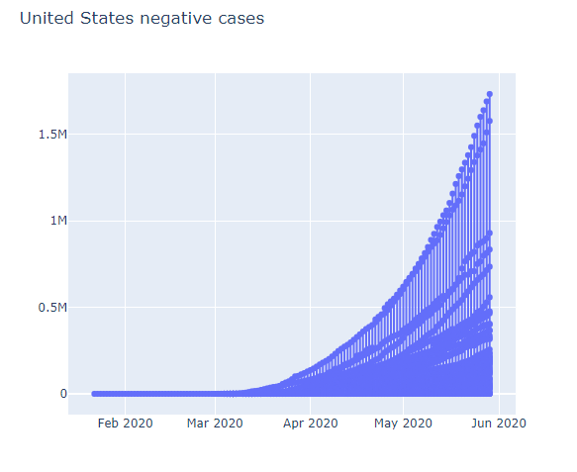
Other visualizations

Slide 7
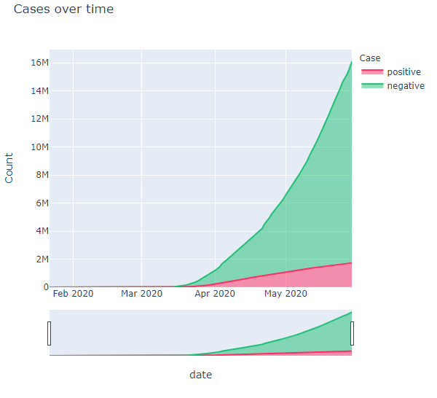
More misc. visualizations

